Slide 1
Behavioural & Experimental Economics Strategic Interaction
Lunzheng Li
University of Cyprus

Slide 2
Course Outline
Choice under Certainty
Judgement under Risk & Uncertainty
Choices under Risk & Uncertainty
Intertemporal Choice
Strategic Interaction

Slide 3
Course Outline
Choice under Certainty
Judgement under Risk & Uncertainty
Choices under Risk & Uncertainty
Intertemporal Choice
Strategic Interaction
Analytical Game Theory
Behavioral Game Theory

Slide 4
Behavioural Game Theory
Analytical game theory is a huge success story in many ways. It is increasingly becoming the foundation of other subdisciplines of economics and has migrated to philosophy, biology, political science, government, public policy, and elsewhere.
However, its descriptive adequacy and normative correctness are controversial.
Behavioural game theory examines the degree to which analytical game theory succeeds in capturing the behaviour of real people engaging in strategic interaction and proposes extensions of analytical game theory in the interest of capturing that behaviour.

Slide 5
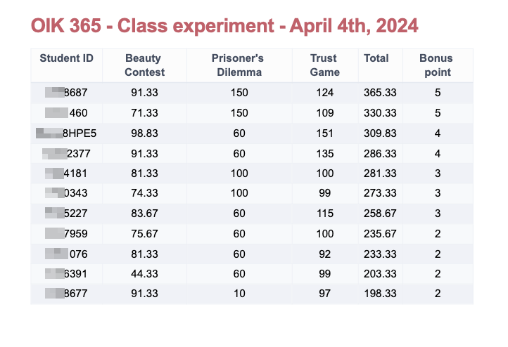

Slide 6
Social Preferences

Slide 7
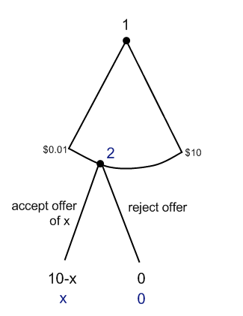
The Ultimatum Game
Let us assume that each individual is simply trying to maximise their dollar payoffs and that u(x) = x.
There is only one subgame-perfect equilibrium in this game. What is that?
In this equilibrium, Player 1 offers something as small as possible, and Player 2 accepts all offers.

Slide 8
The Dictator Game
The dictator game resembles the ultimatum game, except for the fact that the second stage has been eliminated.
On the assumption that the players’ utility function remains u(x) = x, the Nash equilibrium: Player 1 offers something as small as possible.

Slide 9
Experimental Evidence
The Ultimatum Game
Average offers are around 40% of the total
Very few extreme offers (i.e., below 10%)
Very few overly generous offers (i.e. more than 50%)
Offers of 40-50% are rarely rejected.
Offers below 20% are rejected about half of the time
The Dictator Game
Offer less than in the Ultimatum Game
willing to share a substantial amount (10–30 %)
How can we make sense of the above?

Slide 10
Social preferences
The literature on social preference grapples with these phenomena.
This literature assumes that people sometimes care not only about their own attainment but also about other people’s attainment.
We can model this by assuming that a person P’s utility function u_{P}(·) has two or more arguments. Thus, P’s utility function may be given by u_{P}(x, y), where x is P’s attainment and y is the other person Q’s attainment.

Slide 11
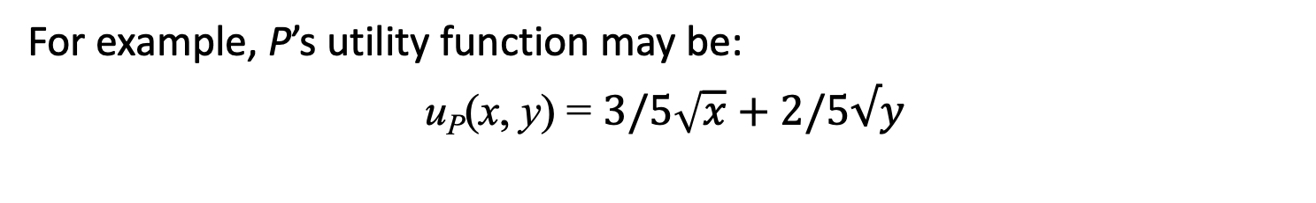
Altruistic Preferences
“[There] are evidently some principles in [man’s] nature, which interest him in the fortune of others, and render their happiness necessary to him”
-- Adam Smith
Some parents, relatives, friends, and admirers are willing to make real sacrifices in order to improve another person’s situation. This is easily explained if we assume that their utility is (in part) a function of the other person’s attainment.
For example, P’s utility function may be:
u_{P}(x, y) = $3/5\sqrt{x}+2/5√y$

Slide 12
Social preferences
Altruistic: derives positive utility from others' attainment.
Envious: derive negative utility from others' attainment.
Fairness: societies should be ordered with respect to justice based on the welfare of the least fortunate in each society.
Inequality averse: care about the degree of inequality among the relevant agents.
Utilitarian: pursue the greatest good for the greatest number.

Slide 13
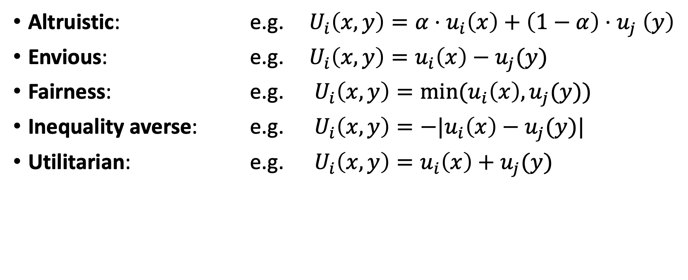
Social preferences
Altruistic: e.g. $U_{i}\left(x,y\right)={α⋅u}_{i}\left(x\right)+\left(1−α\right){⋅u}_{j}\left(y\right)$
Envious: e.g. $U_{i}\left(x,y\right)=u_{i}\left(x\right)−u_{j}(y)$
Fairness: e.g. $U_{i}\left(x,y\right)={min⁡(u}_{i}\left(x\right),u_{j}(y))$
Inequality averse: e.g. $U_{i}\left(x,y\right)={−|u}_{i}\left(x\right)−u_{j}(y)|$
Utilitarian: e.g. $U_{i}\left(x,y\right)=u_{i}\left(x\right)+u_{j}(y)$

Slide 14
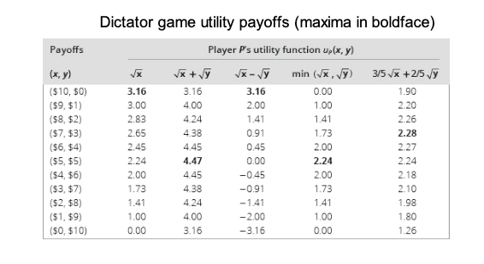

Slide 15
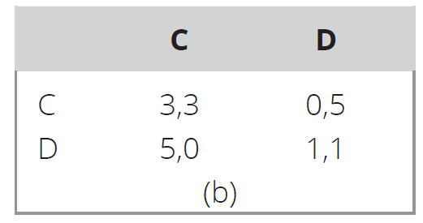

Example
Let us consider the Prisoner’s Dilemma game from before. Suppose the players both care about fairness: $U_{i}\left(x,y\right)={min⁡(u}_{i}\left(x\right),u_{j}(y))$
Then the game is tranformed:
0,0
0,0

Slide 16
 | ID | Choice | Payoff
Pair 1 | 1 | A | 60
 | 2 | A | 60
Pair 2 | 3 | A | 60
 | 4 | A | 60
Pair 3 | 5 | B | 100
 | 6 | B | 100
Pair 4 | 7 | A | 150
 | 8 | B | 10
Pair 5 | 9 | A | 60
 | 10 | A | 60
Pair 6 | 11 | A | 150
 | 12 | B | 10

Slide 17
Intentions , Reciprocity and Trust

Slide 18
Intentions, reciprocity and trust
Social preferences cannot explain the rejections in the ultimatum game, unless individuals are both altruistic and envious.
Another explanations is that ‘intentions matter’: people care about how others treat them, not only the outcomes per se.
Example:
In an experiment proposers could only choose one of two proposals:
Treatment 1: choose between (€10, €0) or (€8, €2)
Treatment 2: choose between (€5, €5) or (€8, €2)
The (€8, €2) proposal was rejected frequently in Treatment 2, but not in Treatment 1.

Slide 19
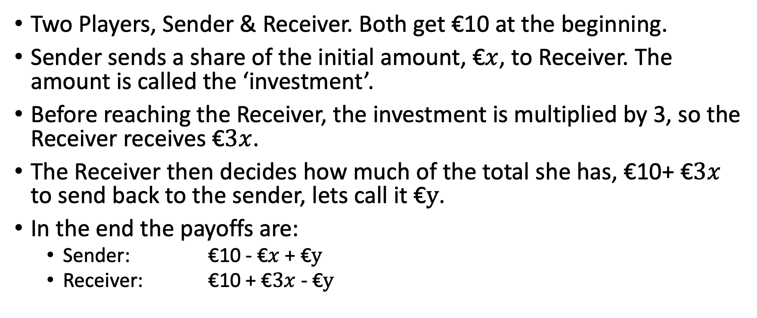
The Trust Game
Two Players, Sender & Receiver. Both get €10 at the beginning.
Sender sends a share of the initial amount, €$x$, to Receiver. The amount is called the ‘investment’.
Before reaching the Receiver, the investment is multiplied by 3, so the Receiver receives €$3x$.
The Receiver then decides how much of the total she has, €10+ €$3x$ to send back to the sender, lets call it €$y$.
In the end the payoffs are:
Sender: €10 - €$x$ + €$y$
Receiver: €10 + €$3x$ - €$y$

Slide 20
The trust game
What would you do as a Sender?
What would you do as a Receiver?
What do you think people usually do?

Slide 21
The trust game
What would you do as a Sender?
What would you do as a Receiver?
What do you think people usually do?
In experiments:
Senders send on average around €5
Receivers return on average between €4 and €5.

Slide 22
The Public Good Game
You will be set in a group with 3 other participants. You will interact with the same group of participants for 10 rounds.
In each round, each member of the group receives an endowment of 20 points. Each member must decide on their contribution to a joint project, which comes out of their endowment. The contribution can be any integer number from 0 points to 20 points.
The sum of all contributions is doubled and then shared evenly among all group members.

Slide 23
The Public Good Game

Slide 24
The Public Good Game

Slide 25
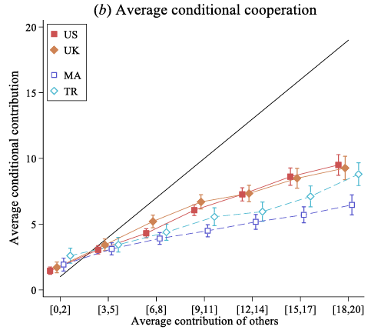
The Public Good Game
This pattern of declining contributions is very typical in this experiment and has been observed all over the world.
One possible explanation is conditional cooperation
It is an example of positive reciprocity

Slide 26
Limited Strategic Thinking

Slide 27
Experiment
Choose an integer number between 1 and 100 (inclusive). Write it on a piece of paper.
The winner is the one that comes closest to 2/3 of the average.
E.g. : if the average is 60, then the winner is the one that chose a number closest to 2/3 * 60 = 40.

Slide 28
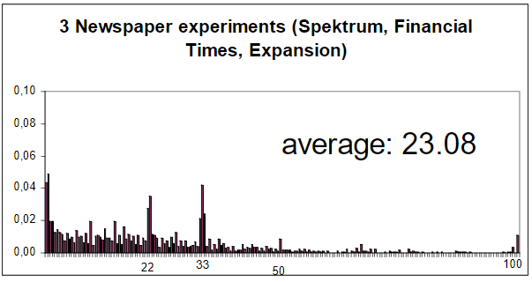

Slide 29
Level-k thinking
Individuals have different depths of reasoning.
Level-0 players play non-strategically (often assumed to just play randomly).
Level-1 players believe everyone else is level-0 and best respond given these beliefs.
Level-2 players believe everyone else is level-1 and best respond given these beliefs.
…
Level-k players believe everyone else is level-(k-1) and best respond given these beliefs.

Slide 30
Level-k thinking
The level-k thinking model often predicts well what people do when faced with a new game, that they have not played before.
If they play the game repeatedly, behavior starts approximating more to that predicted by Nash equilibrium.
One issue with the Level-k model is that it gives clear predictions for each level, but is mute about what the distribution of levels is.

